Slide 1
NLI Data Sanity Check: Assessing the Effect of Data Corruption on Model Performance
Aarne Talman , Marianna Apidianaki , Stergios Chatzikyriakidis , Jorg Tiedemann
ACM, 10 Apr 2021
Presenter : Guo Zikun
Notes:
大家好，我今天要发表的论文题目是，NLI data sanity check:assessing effect of data corruption on model performance.我选这个论文是因为关于数据损坏是我在可解释ai中需要进行解释意义的论证，关于对同等条件下的删除选择，如何保证对本文语义损坏最小。

Slide 2
Contents
Introduction
Experimental method ：Systematic NLI Data Corruption
Result
Conclusion
Notes:
Ok，我首先会向大家介绍什么是数据损坏，然后是这篇论文使用的实验方法，验证损坏的数据对模型有什么影响，然后是关于实验的结果最后是结论。

Slide 3
Introduction
Pretrained neural language models give high performance on natural language inference (NLI) tasks. But whether they actually understand the meaning of the processed sequences remains still unclear. A new test suite which allows to assess whether a dataset a good testbed for evaluating the models’ meaning understanding capabilities was proposed. model accuracy on the corrupted data remains high, then the dataset is likely to contain statistical biases and artefacts that guide prediction. Inversely, a large decrease in model accuracy indicates that the original dataset provides a proper challenge to the models’ reasoning capabilities.,our proposed controls can serve as a crash test for developing high quality data for NLI tasks.

Slide 4
Experiment
Goal : contribute a new suite of diagnostic tests that can be used to assess the quality of an NLU benchmark.
Method : conduct a series of controlled experiments where a set of data corruption transformations are applied to the widely, and explore their impact on fine-tuned BERT and ROBERTa model performance. The obtained results provide evidence that can reveal the quality of a dataset: Given that the transformations seriously affect the quality of NLI sentences, going as far as making them unintelligible
Notes:
这里是实验的设置，我们的目的是：contribute a new suite of diagnostic tests that can be used to assess the quality of an NLU benchmark.

Slide 5
Experiment
A decrease in performance for models fine-tuned on the corrupted dataset would be expected. High performance would indicate the presence of biases and other artefacts in the dataset which guide models’ predictions. This situation would be indicative of a low quality dataset, one we cannot infer safe conclusions about a model’s NLI capabilities.
Notes:
针对前面的实验，我们能够得到如下的期待（Expect the following）

Slide 6
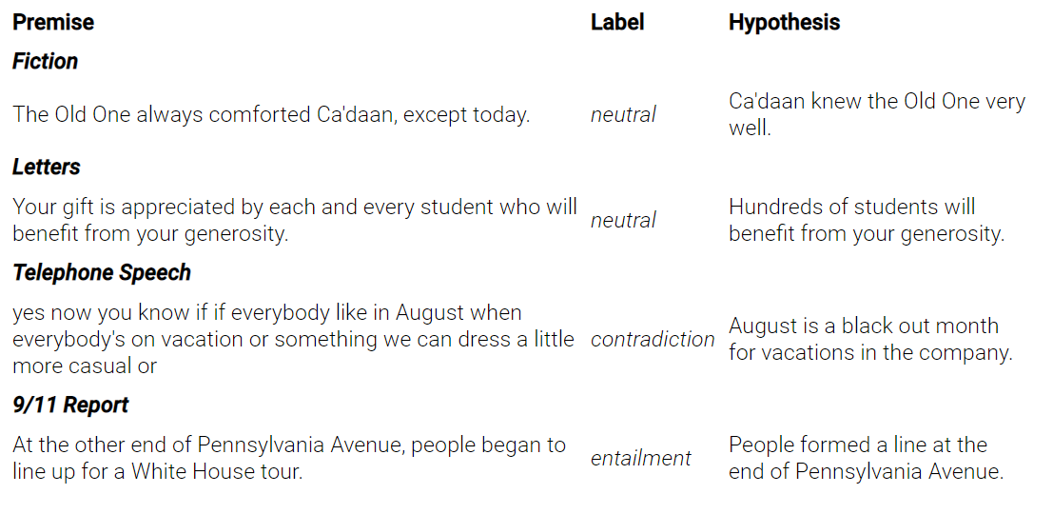
MultiNLI
MultiNLI:
The Multi-Genre Natural Language Inference corpus is a crowd-sourced collection of sentence pairs annotated with textual entailment information. The corpus is modeled on the SNLI corpus, but differs in that covers a range of genres of spoken and written text, and supports a distinctive cross-genre generalization evaluation.
Notes:
这个实验的基础是基于MultiNLi的，在MultiNLI基础上，进行数据损坏，随机化的删除指定类型的句子，首先我介绍什么是MultiNLI。

Slide 7
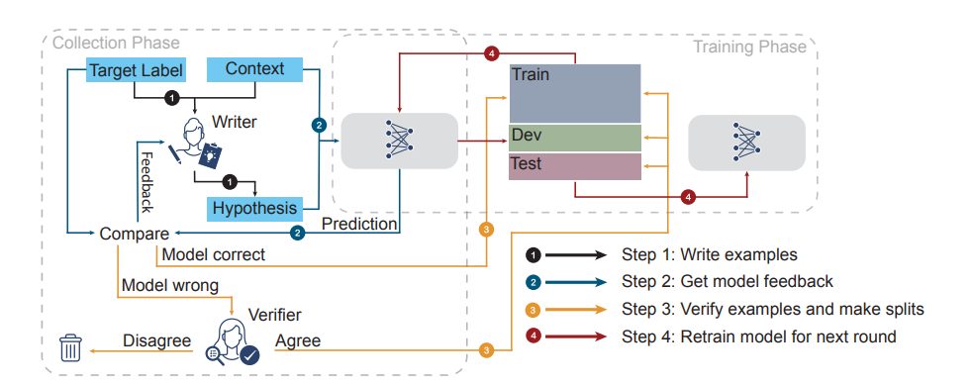
ANLI
Notes:
Adversarial NLI data collection via human-and-model-in-the-loop enabled training (HAMLET). The four steps make up one round of data collection. In step 3, model-correct examples are included in the training set; development and test sets are constructed solely from model-wrong verified-correct examples.

Slide 8
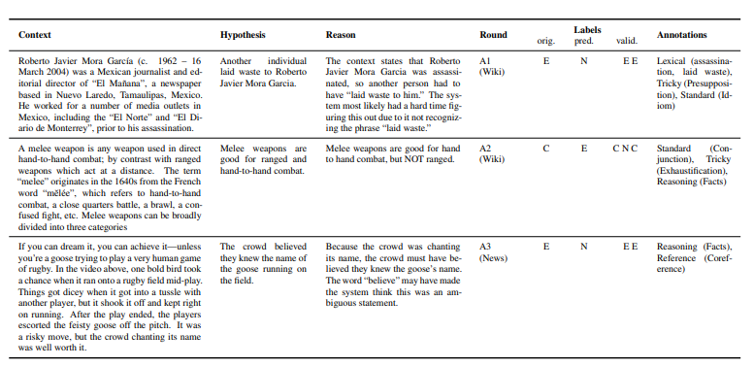
Notes:
对抗性 NLI 基准 (ANLI) 专门门设计用于解决以前 NLI 的一些缺点数据集。 ANLI包含三个数据集（轮次），R1、R2 和 R3。 每个数据集都是使用手动和模型在环方法收集的，并且它们的难度和复杂性正在逐渐增加。在验证集中，使用了模型和人类同时特是的方法，
Examples from development set. ‘An’ refers to round number, ‘orig.’ is the original annotator’s gold label, ‘pred.’ is the model prediction, ‘valid.’ are the validator labels, ‘reason’ was provided by the original annotator, ‘Annotations’ are the tags determined by an expert annotator

Slide 9
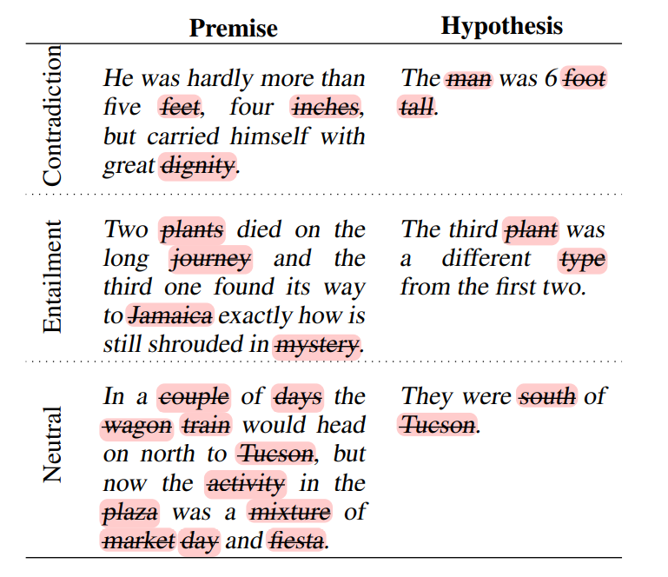
Introduction
Notes:
基于前面的数据集，一部分句子被移除了，这里是句子损坏的例子，在这里例子中，是MULI的全部的名词被移除后的结果。请注意（note）这里的句子损坏和矛盾蕴含中性并不是代表移除后的结果，而是移除前的属性（property）
在这个图片中一共展示了三类语料库的属性：矛盾的（Contradiction）蕴含（Entailment）中性的（Neutral)
同时，在删除了全部名词以后，对模型，进行不同程度的测试，我们就可以结合原来的和腐败的数据集。从而得到是否模型真正的理解或没有

Slide 10
Systematic NLI Data Corruption
MNLI CORRUPT-TRAIN & CORRUPT-TEST ：
Removing words of specific word classes from the MNLI-matched development dataset, or keeping these and removing the rest.
Combine the original MNLI and the corrupted training datasets together.
Notes:
我们通过对原始数据集应用一组受控转换来创建MNLI训练和评估数据的修改版本,被称之为s MNLI CORRUPT-TRAIN and CORRUPT-TEST

Slide 11
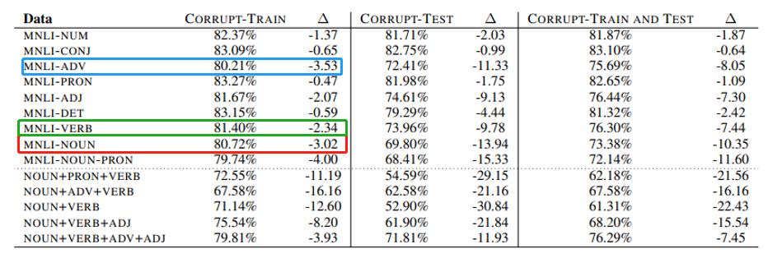
Result
Notes:
这是尝试了不同方法的测试结果，其中2.3行是bert在腐败测试上进行训练，正常测试的结果，45行是。.。56行是。。。。
第一列中给出的结果表明，从 MNLI 训练中删除特定词类的所有出现数据对 BERT 性能的影响出奇地低。正如预期的那样。但是针对adverbs(-3.53）然后是nouns (-3.02) and verbs (-2.34)。因此，我们可以发现：the number of nouns is 4.5 times higher than the number of adverbs in the dataset, suggesting that the latter have a larger impact on NLI prediction.

Slide 12
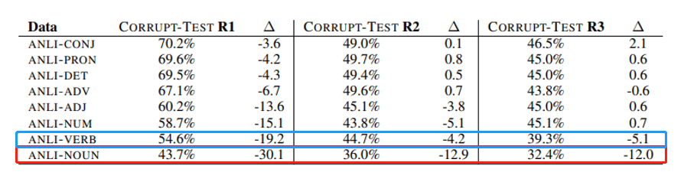
Result
Notes:
为了证明（demonstrate）系统数据损坏(systematic data corruption )可以成为评估评估的有用诊断方法基准质量(branch mark)进行了另一个实验，：this additional experiments on the ANLI test set .The results was from the RoBERTamodel fine tuned on the original training sets and evaluated on CORRUPT-TEST R1, R2 and R3 data
we observe a clear decrease where (-NOUNS, -VERBS) was removed .
(一个可能的解释是，与其他 NLI 数据集相比，ANLI 中的句子（尤其是前提）要长得多，因此删除非内容承载的词使模型更容易掌握做出正确预测的基本信息。
A possible explanation is that as the sentences (especially the premises) are much longer in ANLI compared to other NLI datasets, removing non-content-bearing words makes it easier for the model to grasp the essential information for making correct predictions. )

Slide 13
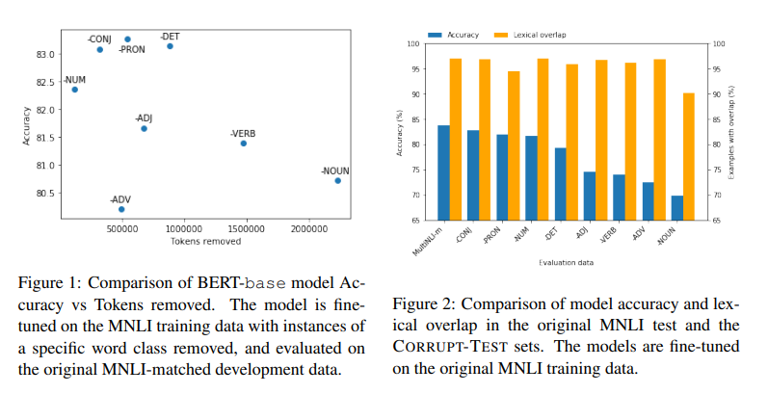
Result
Notes:
这组测试是为了弄清楚到底什么类型的类型（adverbs？Numbers? Adjective?）在被模型观察？针对模型预测准确率突然的下降是否可以作为这个词被监视的解释，我们通过词类被标记的数量进行解释：第一个实验是在bert上删除不同类型的词，并且标记词类的数量。我们可以发现结果是混乱的，我们并不能确定什么词对模型的性能有特殊的影响。
但是第二个实验说明了结果的解释了在这种情况的原因：amount of lexical overlap between premises and hypotheses (% calculated over the total number of examples) in the original MNLI and the CORRUPT-TEST test sets. The blue bars show the prediction accuracy obtained by BERT fine-tuned on the original MNLI data when evaluated. there is a decrease in lexical overlap in some test sets, so suggests that the model picks up on other cues that remain in the corrupted sentences for prediction.

Slide 14
Evaluation
Neural network models that beat human performance in NLU tasks actually understand language is currently much debated.
BERT performs surprisingly well in these experiments. This indicates that rather than understanding the meaning of the sentences and the semantic relationship between them, the models are able to pick up on other cues from the data that allow them to make correct predictions.

Slide 15
Conclusion
Data corruption is an efficient way to estimate dataset quality and their potential to reflect the real language understanding capabilities of the models.
CORRUPT methodology can successfully identify datasets of high or low quality and can be used for assessing the quality of existing benchmarks used by the community and interpreting the results.
Notes:
结论

Slide 16
Thanks
Notes:
结论

